Slide 1
Web Search (1)
References:
Gerald Benoit, Simmons College, Web Search
Dustin Boswell, Distributed Web Crawling
Pandu Nayak and Prabhakar Raghavan，Stanford University
Edt. By: Qingcai Chen, HITSZ

Slide 2
Content
Overview of web search
Web crawler
Politeness
Performance
Indexing/ranking
Scalability
(later lessons)

Slide 3
Web Search
Goal
Provide information discovery for large amounts of open access material on the web
Challenges
Volume of material -- several billion items, growing steadily
Items created dynamically or in databases (deep web, about 150 times of web pages of surface web)
Great variety -- length, formats, quality control, purpose, etc.
Inexperience of users -- range of needs
Economic models to pay for the service

Slide 4
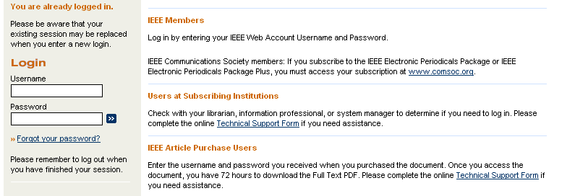
Economic Models
Subscription
Monthly fee with logon provides unlimited access (introduced by InfoSeek)
Pay annually or monthly

Slide 5

Economic Models
Advertising
Access is free, with display advertisements (introduced by Lycos, but boosted by Google®)
Can lead to distortion of results to suit advertisers (Don't be evil?)

Slide 6
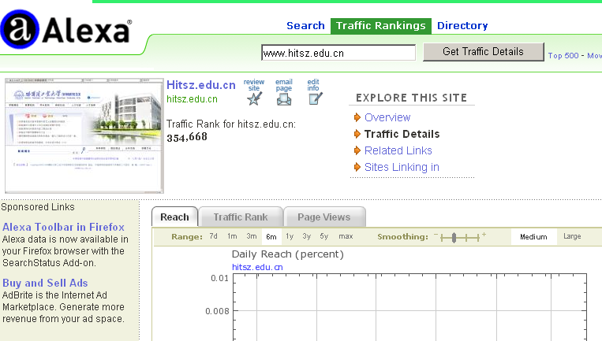
Economic Models
Advertising
Traffic Ranking, the “life” of a commercial search engine!
Notes:
测试一个网站有多少点击量的网站。

Slide 7
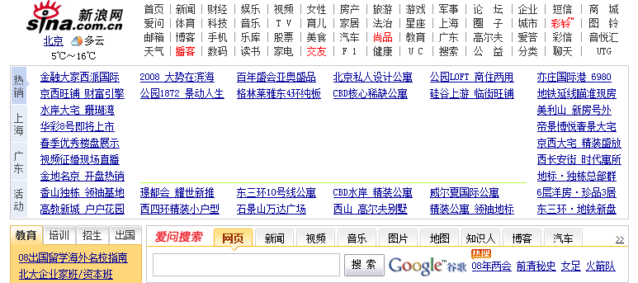
Economic Models
Licensing
Cost of company are covered by fees, licensing of software and specialized services

Slide 8
Strategies
Subject hierarchies — 1st Generation
• Yahoo! -- use of human indexing
Web crawling + automatic indexing – 2nd Generation
• General -- Google, Baidu, Infoseek, Lycos, AltaVista,...
Mixed models
• Human directed web crawling and automatic indexing

Slide 9
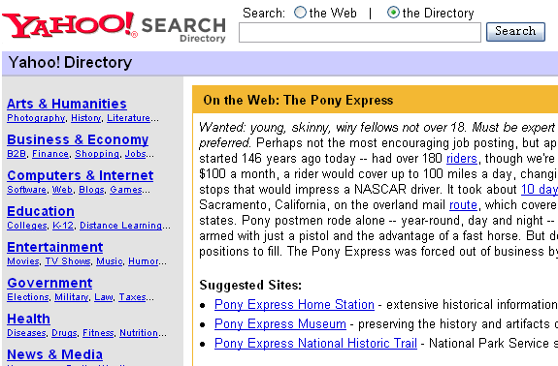
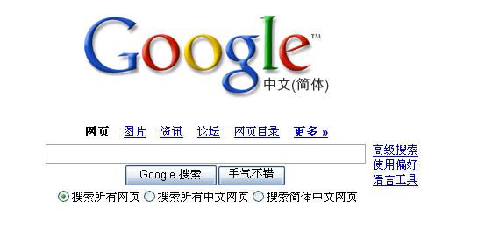

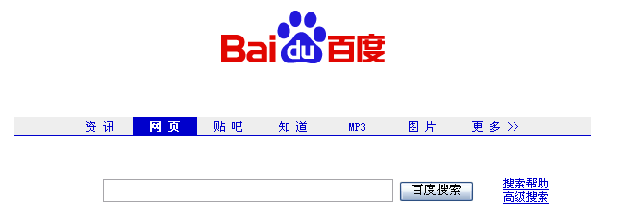
Strategies - Examples

Slide 10
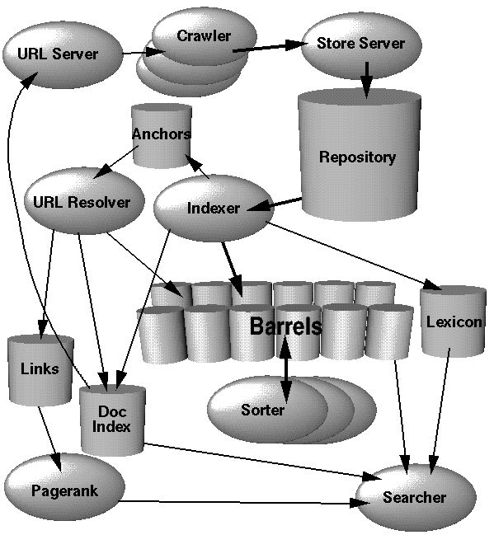
Components of Web Search Service
Components
• Web crawler
• Indexing system
• Search system
Considerations
• Economics
• Scalability
• Legal issues

Slide 11
Content
Overview of web search
Web crawler
Politeness
Performance

Slide 12
What is a Web Crawler?
Web Crawler? What? How?
• A program for downloading web pages.
• Given an initial set of seed URLs, it recursively downloads every page that is linked from pages in the set.
• Variations:
A focused web (专业爬虫) crawler downloads only those pages whose content satisfies some criterion. (Needs the support of categorization approaches)
A deep web crawler downloads dynamic web content (trends to be hot!)
Also known as a web spider

Slide 13
Simple Web Crawler Algorithm
Basic Algorithm
Let S be set of URLs to pages waiting to be indexed. Initially S is the singleton, s, known as the seed.
Take an element u of S and retrieve the page, p, that it references.
Parse the page p and extract the set of URLs L it has links to.
Update S = S + L - u
Repeat as many times as necessary.

Slide 14
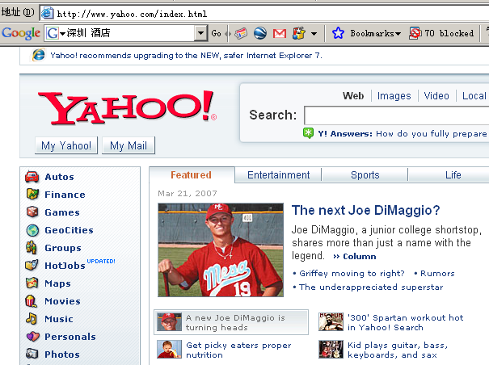
Simple Web Crawler Algorithm (cont’d)
UrlsTodo = {‘‘yahoo.com/index.html’’}
Repeat:
url = UrlsTodo.getNext()
html = Download( url )
UrlsDone.insert( url )
newUrls = parseForLinks( html )
For each newUrl not in UrlsDone:
UrlsTodo.insert( newUrl )
http://sports.yahoo.com/mlb/news?slug=ti-mlb_07_dimaggio031907&prov=yhoo&type=lgns

Slide 15
Not so simple…
Performance -- How do you crawl 1,000,000,000 pages?
Politeness -- How do you avoid overloading servers?
Failures -- Broken links, time outs, spider traps.
Strategies -- How deep do we go? Depth first or breadth first?
Implementations -- How do we store and update S and the other data structures needed? (Parallel file system?)
Notes:
2013.11.11: Give the questions to students and left parts could be the content of the next lesson for 45 minutes.

Slide 16
What to retrieve
No web crawler retrieves everything
Most crawlers retrieve only
HTML (leaves and nodes in the tree)
ASCII clear text (only as leaves in the tree)
Some retrieve
PDF
PostScript,…
Indexing after crawl
Some index only the first part of long files
Do you keep the files (e.g., Google cache)?

Slide 17

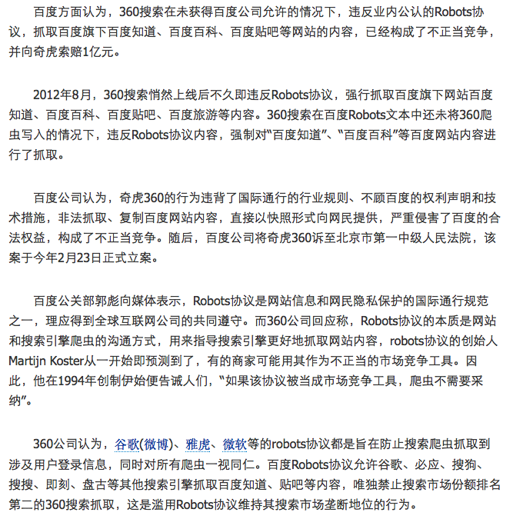
Robots Exclusion – “gentlecrawler”
The Robots Exclusion Protocol
A Web site administrator can indicate which parts of the site should not be visited by a robot, by providing a specially formatted file on their site, in http://.../robots.txt.
The Robots META tag
A Web author can indicate if a page may or may not be indexed, or analyzed for links, through the use of a special HTML META tag
See: http://www.robotstxt.org/wc/exclusion.html

Slide 18
Robots Exclusion
Example file: /robots.txt
# Disallow allow all robots
User-agent: *
Disallow: /cyberworld/map/
Disallow: /tmp/ # these will soon disappear
Disallow: /foo.html
# To allow Cybermapper
User-agent: cybermapper
Disallow:

Slide 19
Extracts from: http://www.google.com/robots.txt
User-agent: *
Allow: /searchhistory/
Disallow: /search
Disallow: /groups
Disallow: /images
Disallow: /catalogs
Disallow: /catalogues
Disallow: /news
Disallow: /nwshp
Disallow: /?
Disallow: /addurl/image?
Disallow: /pagead/
Disallow: /relpage/
Disallow: /relcontent
……

Slide 20
The Robots META tag
The Robots META tag allows HTML authors to indicate to visiting robots if a document may be indexed, or used to harvest more links. No server administrator action is required.
Note that currently only a few robots implement this.
In this simple example:
<meta name="robots" content="noindex, nofollow">
a robot should neither index this document, nor analyze it for links.
http://www.robotstxt.org/wc/exclusion.html#meta

Slide 21
Content
Overview of web search
Web crawler
Politeness
Performance

Slide 22
Statistics to Keep in Mind
Documents on the web:
Avg. HTML size:
Avg. URL length:
Links per page:
External Links per page:
8 Billion + (by Google’s count, early than 2005, >10 Billions now)
15KB
50+ characters
10
2
Download the entire web in a year: 2026 urls / second !
8 Billion * 15KB = 120 TeraBytes of HTML
8 Billion * 50 chars = 400 GigaBytes of URL’s !!
→ multiple machines required

Slide 23
Distributing the Workload
Internet
Machine
0
Machine
1
Machine
N-1
LAN
Each machine is assigned a fixed subset of the url-space
Then how to assign the tasks?
Notes:
Notice we want a hash function that keeps url’s from the same domain together:
- Most links are local, keeps communication down.
- Dns caching works.
- Can maintain politeness : otherwise we’ll appear as a denial of service attack.

Slide 24
Distributing the Workload
Internet
Machine
0
Machine
1
Machine
N-1
LAN
Each machine is assigned a fixed subset of the url-space
machine = hash( url’s domain name )% N
Notes:
Notice we want a hash function that keeps url’s from the same domain together:
- Most links are local, keeps communication down.
- Dns caching works.
- Can maintain politeness : otherwise we’ll appear as a denial of service attack.

Slide 25
Distributing the Workload
Internet
Machine
0
Machine
1
Machine
N-1
LAN
cnn.com/sports
cnn.com/weather
cbs.com/csi_miami
…
bbc.com/us
bbc.com/uk
bravo.com/queer_eye
…
Each machine is assigned a fixed subset of the url-space
machine = hash( url’s domain name )% N
Notes:
Notice we want a hash function that keeps url’s from the same domain together:
- Most links are local, keeps communication down.
- Dns caching works.
- Can maintain politeness : otherwise we’ll appear as a denial of service attack.

Slide 26
Distributing the Workload
Internet
Machine
0
Machine
1
Machine
N-1
LAN
cnn.com/sports
cnn.com/weather
cbs.com/csi_miami
…
bbc.com/us
bbc.com/uk
bravo.com/queer_eye
…
Each machine is assigned a fixed subset of the url-space
machine = hash( url’s domain name )% N
Communication: a couple urls per page (very small)
DNS cache per machine
Maintain politeness : don’t want to DOS (Denial of Service) attack someone!
Notes:
Notice we want a hash function that keeps url’s from the same domain together:
- Most links are local, keeps communication down.
- Dns caching works.
- Can maintain politeness : otherwise we’ll appear as a denial of service attack.

Slide 27
Software Hazards
Slow/Unresponsive DNS Servers
Slow/Unresponsive HTTP Servers
Large or Infinite-sized pages
Infinite Links (“domain.com/time=100”, “…101”, “…102”, …)
Broken HTML
parallel / async
interface desired
Notes:
Infinite：无穷

Slide 28
Building a Web Crawler: Links are not Easy to Extract
Relative/Absolute
CGI
Parameters
Dynamic generation of pages
Server-side scripting
Server-side image maps
Links buried in scripting code (e.g. in Java Script or JS)
Notes:
Extract：取出 挖掘

Slide 29
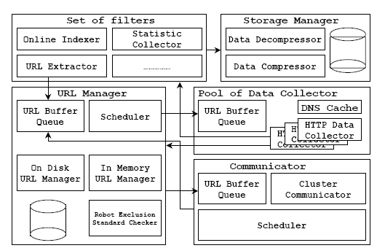
An example crawler - architecture
Koht-arsa, Sanguanpong, High performance large scale web spider architecture. 2002

Slide 30
Example crawler architecture (Cont’d)
URL Manager
The URL Manager keeps track of all the URL set of that node.
Pool of data collector
The pool of data collector queue the URL list sent from the URL Manager. It has many collector threads to fetch the data from the web servers.
Set of filters
link extract
collection statistic
online indexer
Storage manager
The storage manager’s role is compression and decompressions, storing and retrieving the data.
Data compressing: zlib, lzo, etc.
Communicator
The communicator send/receive new URLs found from the node that found it to the node that responsible to manage it.

Slide 31
Communication between nodes
Sec. 20.2.1
Output of the URL filter at each node is sent to the Dup URL Eliminator of the appropriate node
WWW
DNS
To
other
nodes
URL
set
Parse
Doc
FP’s
robots
filters
Fetch
Content
seen?
URL
filter
Host
splitter
Dup
URL
elim
From
other
nodes
URL Frontier

Slide 32
URL frontier: Mercator scheme
Sec. 20.2.3
URLs
Prioritizer
K front queues
Biased front queue selector
Back queue router
B back queues
Single host on each
Back queue selector
Crawl thread requesting URL

Slide 33
Front queues
Sec. 20.2.3
Prioritizer
1
K
Biased front queue selector
Back queue router

Slide 34
Front queues
Sec. 20.2.3
Prioritizer assigns to URL an integer priority between 1 and K
Appends URL to corresponding queue
Heuristics for assigning priority
Refresh rate sampled from previous crawls
Application-specific (e.g., “crawl news sites more often”)
34

Slide 35
Biased front queue selector
Sec. 20.2.3
When a back queue requests a URL (in a sequence to be described): picks a front queue from which to pull a URL
This choice can be round robin biased to queues of higher priority, or some more sophisticated variant
Can be randomized

Slide 36
Back queues
Sec. 20.2.3
Biased front queue selector
Back queue router
1
B
Heap
Back queue selector
Notes:
一个IP对应一个queue

Slide 37
Back queue invariants
Sec. 20.2.3
Each back queue is kept non-empty while the crawl is in progress
Each back queue only contains URLs from a single host
Maintain a table from hosts to back queues
Host name | Back queue
… | 3
 | 1
 | B

Slide 38
Back queue heap
Sec. 20.2.3
One entry for each back queue
The entry is the earliest time t_{e} at which the host corresponding to the back queue can be hit again
This earliest time is determined from
Last access to that host
Any time buffer heuristic we choose
Notes:
一个queue对应了一个ip的所有文件地址，当这个queue为空后，要取新的ip，此时用最小堆，判断谁距离上一次被选中的时间最近，那么这个queue下一个就可以保存这个ip的文件地址。

Slide 39
Back queue processing
Sec. 20.2.3
A crawler thread seeking a URL to crawl:
Extracts the root of the heap
Fetches URL at head of corresponding back queue q (look up from table)
Checks if queue q is now empty – if so, pulls a URL v from front queues
If there’s already a back queue for v’s host, append v to that queue and pull another URL from front queues, repeat
Else add v to q
When q is non-empty, create heap entry for it

Slide 40
Number of back queues B
Sec. 20.2.3
Keep all threads busy while respecting politeness
Mercator recommendation: three times as many back queues as crawler threads
40

Slide 41
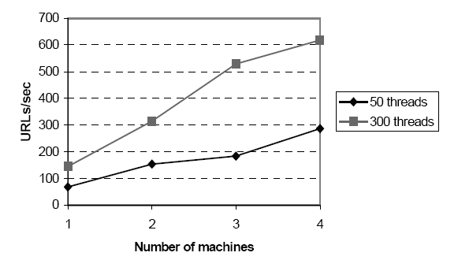
Example crawler – gathering speed

Slide 42
Discussion
• How frequently to crawl and what strategies to use?
• Duplicate (重复) detection?
• How to avoid spam?
• Strategies for crawling based on the content of web pages (focused and selective crawling).

Slide 43
Question?

Slide 44
Reading Report: IRLbot: Collecting 6 Billion Pages within 41 Days?
WWW’08 best paper
Hsin-Tsang Lee, Derek Leonard, Xiaoming Wang, and Dmitri Loguinov, IRLbot: Scaling to 6 Billion Pages and Beyond. WWW’08, Beijing, China
They are trying to address the key problems of a crawler, i.e.
Scalability: DRUM (Disk Repository with Update Management)
Spam avoidance: STAR
Politeness: BEAST
Details……

Slide 45
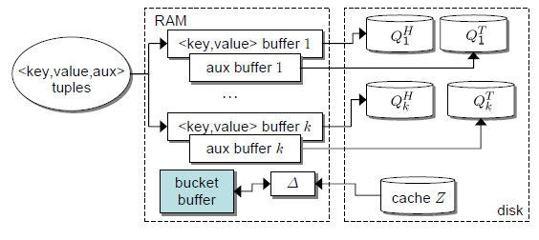
DRUM (Disk Repository with Update Management)

Slide 46
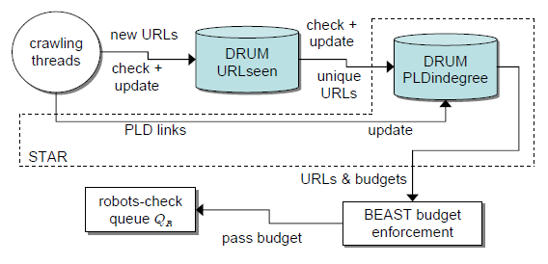
STAR (Spam Tracking and Avoidance through Reputation)
Set URL budget of for each pay-level domain (PLD) according to
its PLDIndegree (PLD入度)

Slide 47
BEAST (Budget Enforcement with Anti-Spam Tactics)
keep t₀ = 40 seconds for accessing all low-ranked PLDs
for high-ranked PLDs scale it down proportional to their budget B_{x} t₁ ∝ (1/B_{x})* t₀

Slide 48
Discussion
Though high performance they reached, some issues are still left:
Downloading of large files
Webpage refreshing
Intellectual property protection
Web servers’ bandwidth wasting
etc.

Slide 49
Further Reading
“IRLbot: Collecting 6 Billion Pages within 41 Days?”, WWW’08
Heritrix
http://crawler.archive.org/
Larbin
http://larbin.sourceforge.net/index-eng.html
Allan Heydon and Marc Najork, Mercator: A Scalable, Extensible Web Crawler. Compaq Systems Research Center, June 26, 1999. http://www.research.compaq.com/SRC/mercator/papers/www/paper.html
Koht-arsa, Sanguanpong, High performance large scale web spider architecture. The 2002 Internataional Symposium on Communications and Information Technology, Thailand, October 2002
Dustin Boswell dboswell et al, Distributed High-performance Web Crawlers: A Survey of the State of the Art .

Slide 50
Backup
More examples of web crawler
Google
Mercator ( for AltaVista)
Heritrix
Labin

Slide 51
Previous Web Crawlers
 | Google Prototype – 1998 | Mercator – 2001 (used at AltaVista)
Downloading (per machine): | 300 asynch connections | 100’s of synchronous threads
Crawling Results: | 4 machines 24 million pages 48 pages/ second | 4 machines 891 million 600 pages/second

Slide 52
Example: Heritrix Crawler
A high-performance, open source crawler for production and research
Developed by the Internet Archive and others
Before Heritrix, Cornell computer science used the Mercator web crawler for experiments in selective web crawling (automated collection development). Mercator was developed by Allan Heydon, Marc Njork and colleagues at Compaq Systems Research Center. This was continuation of work of Digital's AltaVista group.

Slide 53
Heritrix: Design Goals
Broad crawling: Large, high-bandwidth crawls to sample as much of the web as possible given the time, bandwidth, and storage resources available.
Focused crawling: Small- to medium-sized crawls (usually less than 10 million unique documents) in which the quality criterion is complete coverage of selected sites or topics.
Continuous crawling: Crawls that revisit previously fetched pages, looking for changes and new pages, even adapting its crawl rate based on parameters and estimated change frequencies.
Experimental crawling: Experiment with crawling techniques, such as choice of what to crawl, order of crawled, crawling using diverse protocols, and analysis and archiving of crawl results.

Slide 54
Heritrix
Design parameters
• Extensible. Many components are plugins that can be rewritten for different tasks.
• Distributed. A crawl can be distributed in a symmetric fashion across many machines.
• Scalable. Size of within memory data structures is bounded.
• High performance. Performance is limited by speed of Internet connection (e.g., with 160 Mbit/sec connection, downloads 50 million documents per day).
• Polite. Options of weak or strong politeness.
• Continuous. Will support continuous crawling.

Slide 55
Heritrix: Main Components
Scope: Determines what URIs are ruled into or out of a certain crawl. Includes the seed URIs used to start a crawl, plus the rules to determine which discovered URIs are also to be scheduled for download.
Frontier: Tracks which URIs are scheduled to be collected, and those that have already been collected. It is responsible for selecting the next URI to be tried, and prevents the redundant rescheduling of already-scheduled URIs.
Processor Chains: Modular Processors that perform specific, ordered actions on each URI in turn. These include fetching the URI, analyzing the returned results, and passing discovered URIs back to the Frontier.

Slide 56
Mercator: Main Components
• Crawling is carried out by multiple worker threads, e.g., 500 threads for a big crawl.
• The URL frontier stores the list of absolute URLs to download.
• The DNS resolver resolves domain names into IP addresses.
• Protocol modules download documents using appropriate protocol (e.g., HTML).
• Link extractor extracts URLs from pages and converts to absolute URLs.
• URL filter and duplicate URL eliminator determine which URLs to add to frontier.

Slide 57
Mercator: The URL Frontier
A repository with two pluggable methods: add a URL, get a URL.
Most web crawlers use variations of breadth-first traversal, but ...
• Most URLs on a web page are relative (about 80%).
• A single FIFO queue, serving many threads, would send many simultaneous requests to a single server.
Weak politeness guarantee: Only one thread allowed to contact a particular web server.
Stronger politeness guarantee: Maintain n FIFO queues, each for a single host, which feed the queues for the crawling threads by rules based on priority and politeness factors.

Slide 58
Mercator: Duplicate URL Elimination
Duplicate URLs are not added to the URL Frontier
Requires efficient data structure to store all URLs that have been seen and to check a new URL.
In memory:
Represent URL by 8-byte checksum. Maintain in-memory hash table of URLs.
Requires 5 Gigabytes for 1 billion URLs.
Disk based:
Combination of disk file and in-memory cache with batch updating to minimize disk head movement.

Slide 59
Mercator: Domain Name Lookup
Resolving domain names to IP addresses is a major bottleneck of web crawlers.
Approach:
• Separate DNS resolver and cache on each crawling computer.
• Create multi-threaded version of DNS code (BIND).
These changes reduced DNS loop-up from 70% to 14% of each thread's elapsed time.

